Slide 2
Fast Facts
Founded in 1967
135 acre, park-like campus
The first regional college created by UC and one of the first in Ohio.
5,172 Students (Fall 2019 enrollment)
More than 50 degree and certificate programs, including bachelor’s degrees.

Slide 3
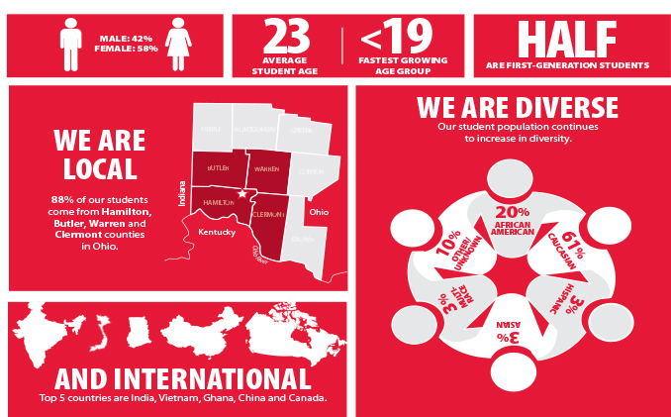
UC Blue Ash is the most diverse UC college.

Slide 4
QUESTIONS?
GET CONNECTED.

