Slide 1
UC Blue Ash College

Slide 2
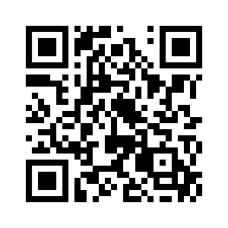
Our campus
our campus
FOUNDED IN
1967
The first regional
college created by
UC and one of the
first in Ohio.
CONVENIENTLY
LOCATED
Easy to access from nearly everywhere in Greater Cincinnati.
VIRTUAL TOUR
Want to see more?
Scan to view our
interactive virtual tour.
135
ACRE CAMPUS

Slide 3
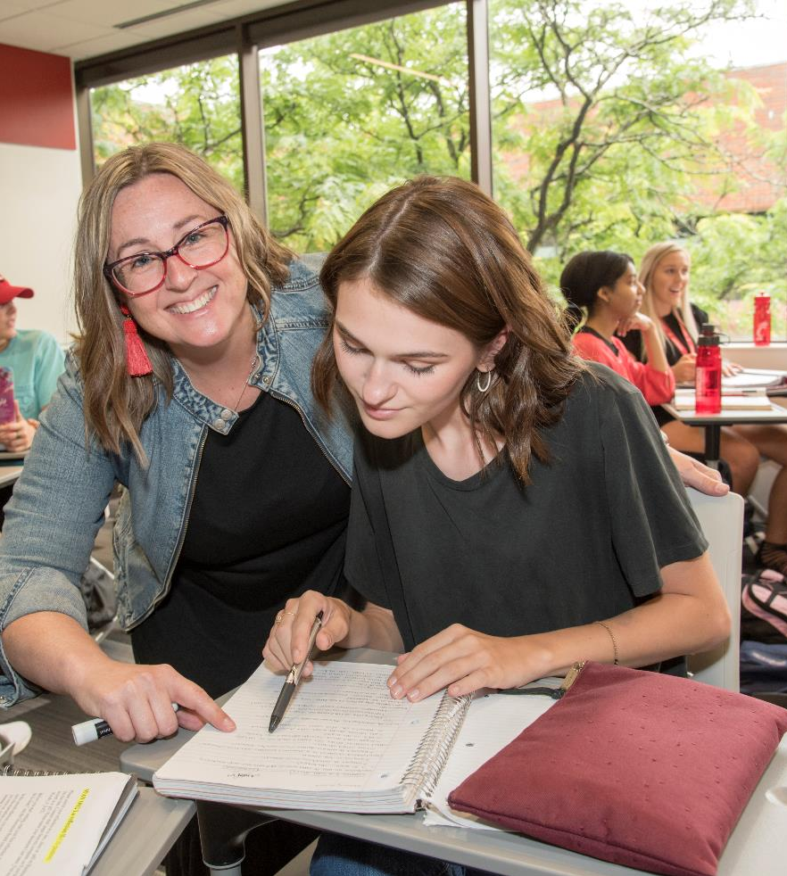
Great education, great value
great education. great value.
We are proud to provide the high-quality education and amazing resources the University of Cincinnati offers, along with the advantages that come with a small college campus – including low tuition, small class sizes, and the personal attention that helps our students thrive.
$7,200
ANNUAL TUITION
Tuition for full-time,
in-state students is just
over $7,000 per year.
$1M+
IN SCHOLARSHIPS IN GRANTS
We offer more than $1 million in scholarships & grants to UC Blue Ash students each year.

Slide 4
Our Students
our students
4,700
STUDENTS
(Projection for Fall 2024. Does not include CCP students).
WE ARE
DIVERSE
We are proud to serve the most diverse student population at the University of Cincinnati.
Asian 5%
Multi-Race 6%
Hispanic Latino 10%
Black 28%
Caucasian 49%
Other/Unknown 2%

Slide 5
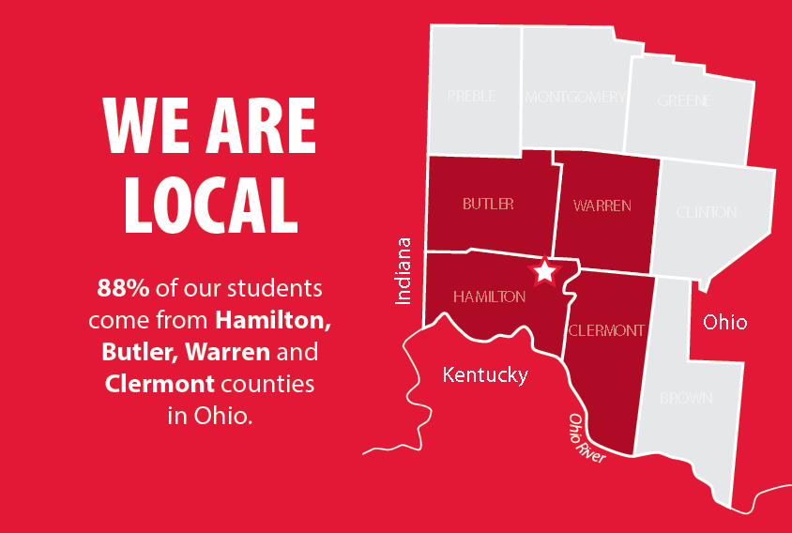
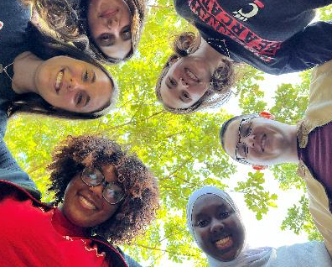
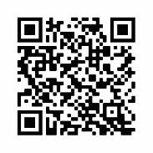
Our Students
our students
45%
WE ARE FIRST
GENERATION
About 45% of UC Blue Ash students are the first in their families to attend college.
45%
WE ARE DEDICATED
More than 75% of UC Blue Ash students work
while taking classes.
MEET OUR
STUDENTS
Hear from our students and see how they’re achieving their dreams.

Slide 6
Our Academics
our academics
50+
16:1
STUDENT TO FACULTY RATIO
We are dedicated to providing a personalized educational experience
DEGREE &
CERTIFICATE
PROGRAMS
NATIONALLY RECOGNIZED, REGIONALLY ACCREDITED
Earn an authentic UC education, and know that you can
transition to other programs or colleges without losing credits.

Slide 7
Our Academics
our academics
TRANSITION PROGRAMS
Provide students with the first two years of their education before transitioning into a baccalaureate program.
CAREER PROGRAMS
Prepare students for entrance into specific careers after two years of study.
BACHELOR DEGREE PROGRAMS
We offer bachelor degrees in different business and health care related fields.

Slide 8
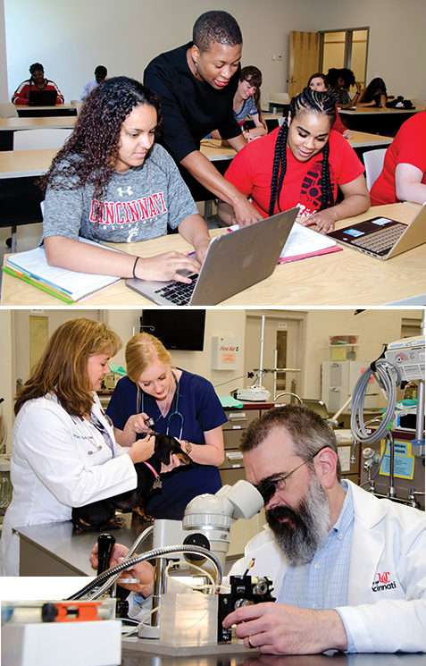
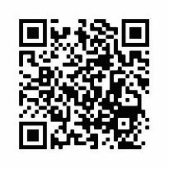
Expert Faculty
expert faculty
Many of our faculty members are leaders in their field of study – publishing, presenting and conducting research. We are proud to be the home of Fulbright Scholars, and national and international award winners.
20
AVERAGE CLASS SIZE
Our faculty are dedicated to teaching
and enjoy the opportunity to get to
know their students.
MEET OUR
FACULTY
Hear from our faculty about our academic programs.

Slide 9
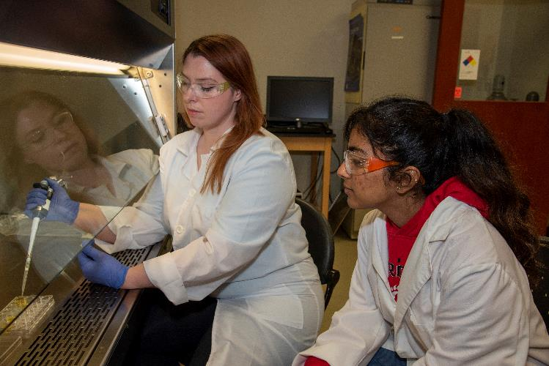
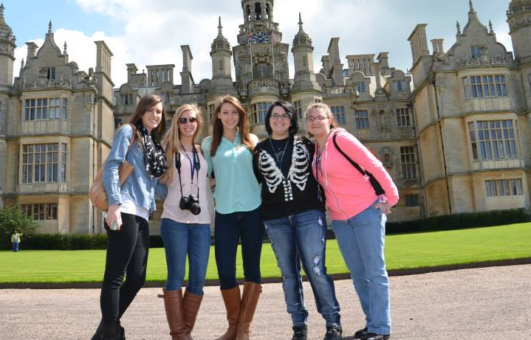
Honors Program
honors program
Students develop online portfolios
Take courses with other Honors students
Complete at least two Honors experiences
Eligible to transition to the University
Honors Program on the Uptown campus

Slide 10
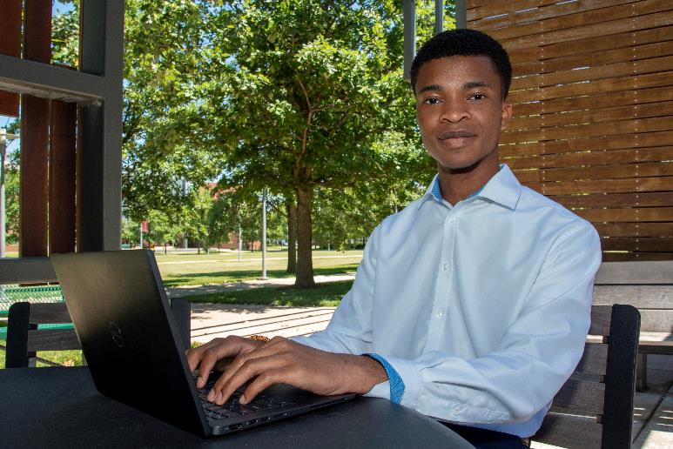
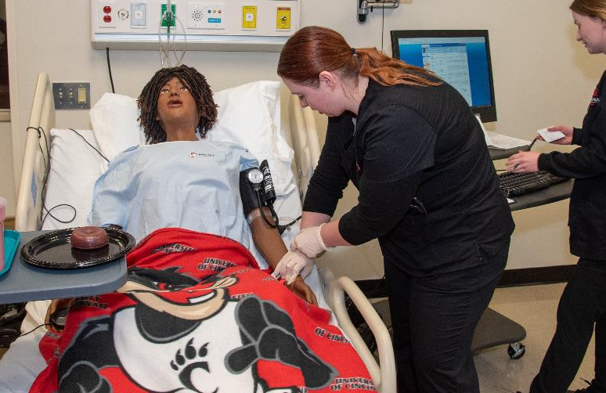
Top Programs
top programs
TOP 5 ACADEMIC PROGRAMS (BY ENROLLMENT)
Pre-Business Administration
Pre-Health Professions
Pre-Engineering
Information Technology
Psychology

Slide 11
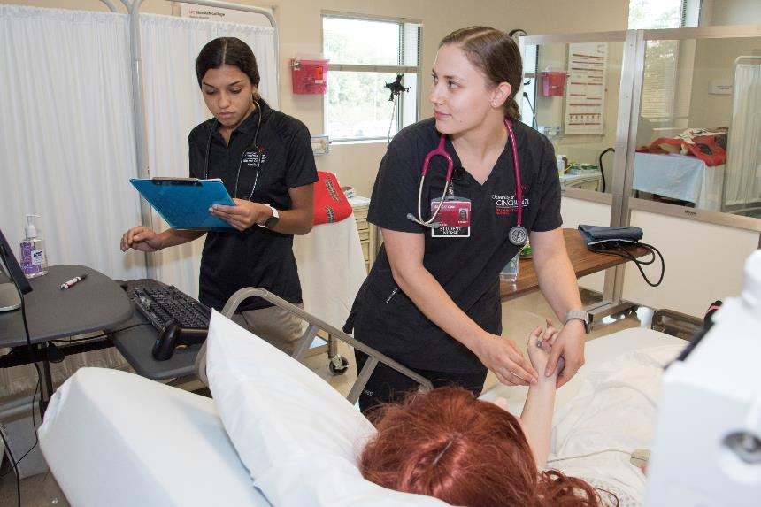
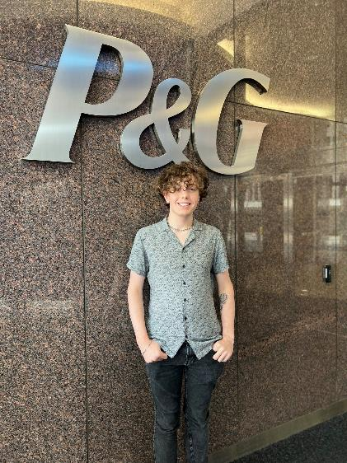
Student Experience
student experience
We offer a wide range of opportunities for students learn and grow outside the classroom:
Clinical Rotations (Health Care)
Co-Op and Internship Program
Over 180 business partnerships
Student Leadership Programs
Student Organizations
Study Abroad

Slide 12
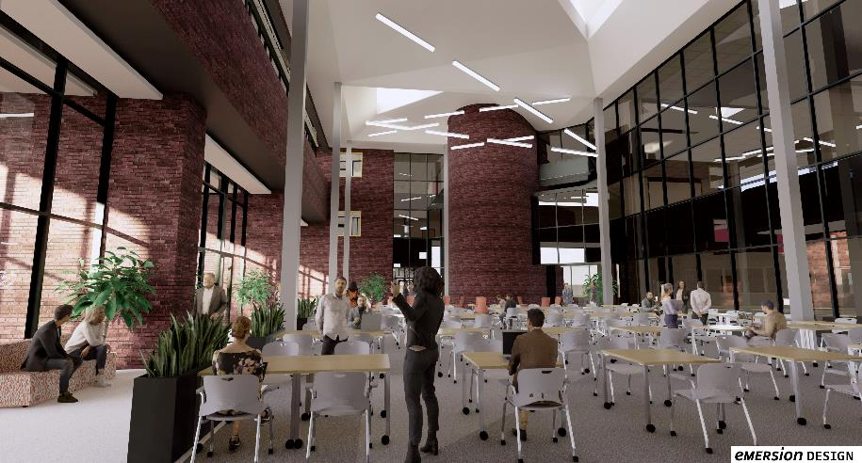
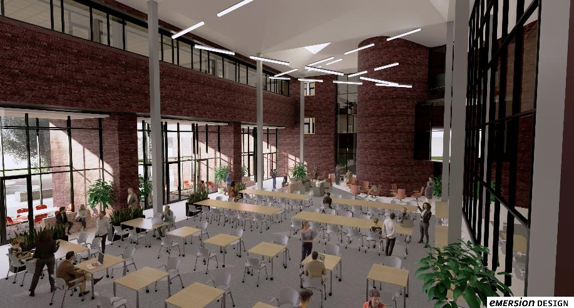
Muntz Renovation
muntz renovation
We are enhancing our campus with a major renovation to Muntz Hall.
Renovated the 2nd and 3rd floors to create modern classrooms, new faculty office suites and new spaces for students.
Working now on 1st floor to create a new wing that brings together important student services, and a beautiful, two-story atrium that will transform our main entrance and provide more areas for students to study or take a break between classes.

Slide 13
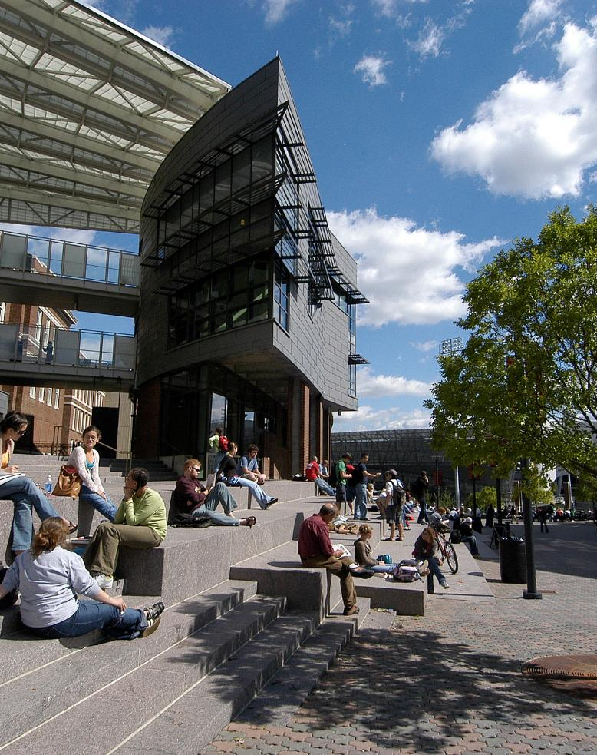
We Are UC
we are uc
Our students are Bearcats!
They have access to all that
comes with being a UC student.
Live on the UC Uptown campus
Join fraternities and sororities
Participate in student clubs
Get student pricing for UC athletic events
Ride our free shuttle to and from UC Uptown Monday–Friday during spring & fall semesters

Slide 14
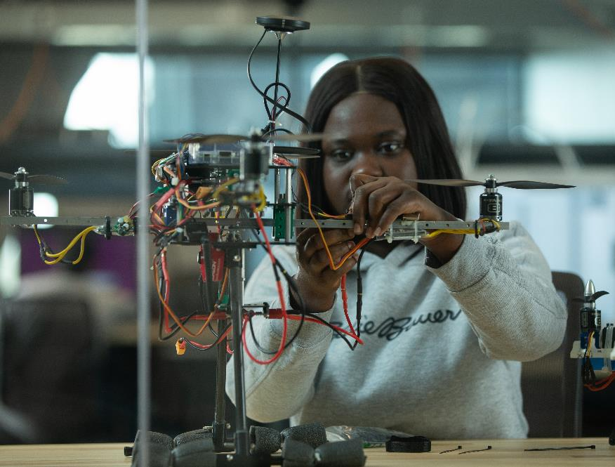
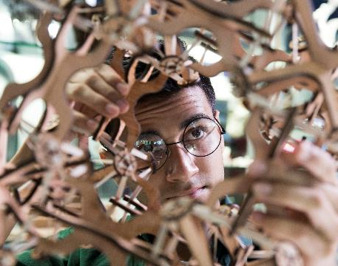
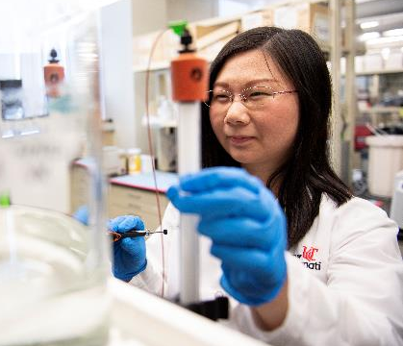
Transition Success
transition success
Each year, hundreds of UC Blue Ash students transition to UC’s Uptown campus.
3.23
AVERAGE GPA IN FIRST YEAR AFTER TRANSITIONING.
Their performance after transition speaks volumes about the level of preparation they receive at our college.

Slide 15
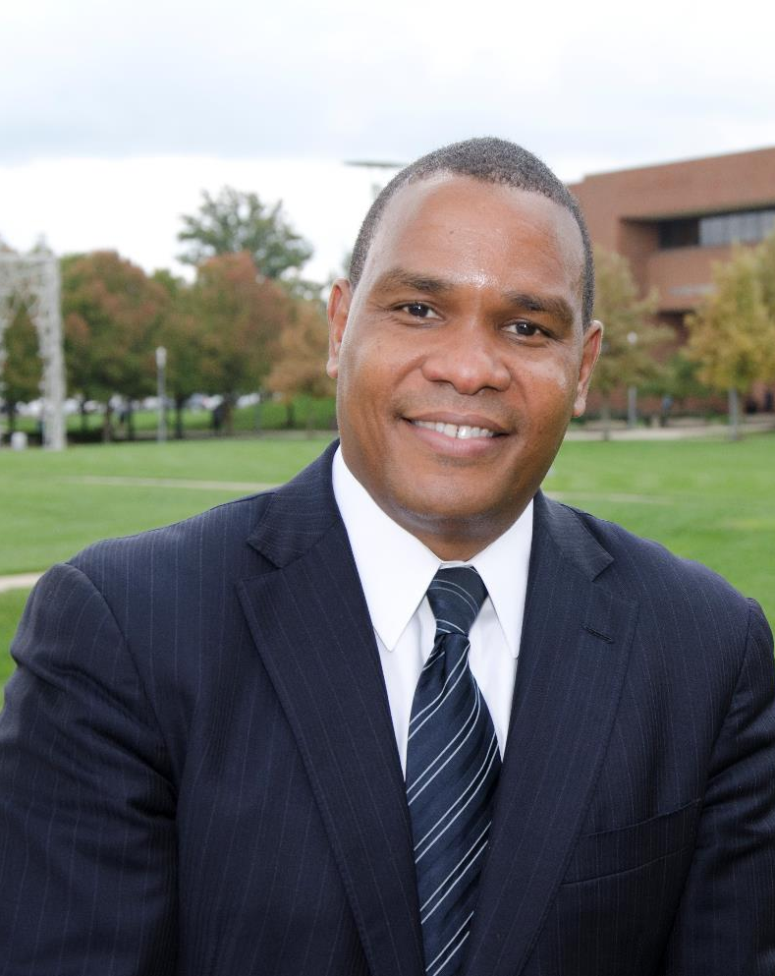
Alumni Everywhere
alumni everywhere
We have more than 26,000 alumni and many are making a positive impact in the Greater Cincinnati region and around the world.
Distinguished Alumnus Eric Broyles (UC Blue Ash ‘90/College of Business ‘92) is a CEO and entrepreneur who showed his gratitude for the huge impact UC Blue Ash made in his life by donating $1 million to our student scholarship fund.

Slide 16
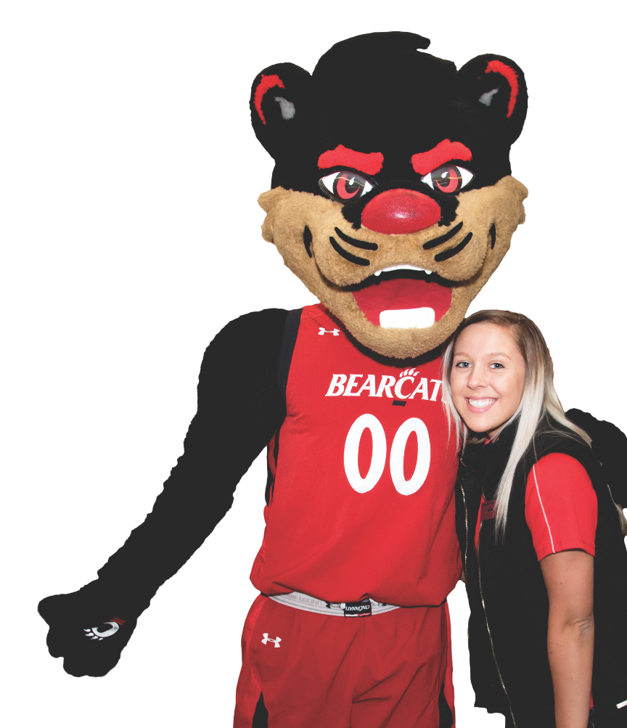
Connect with us
connect with us

